Slide 1
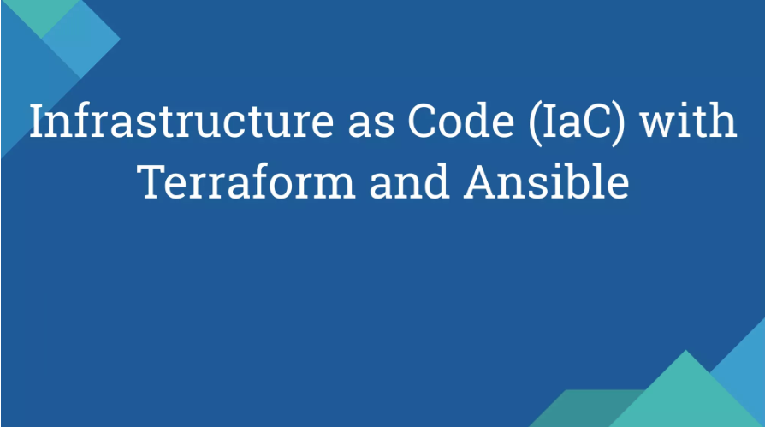

Slide 2
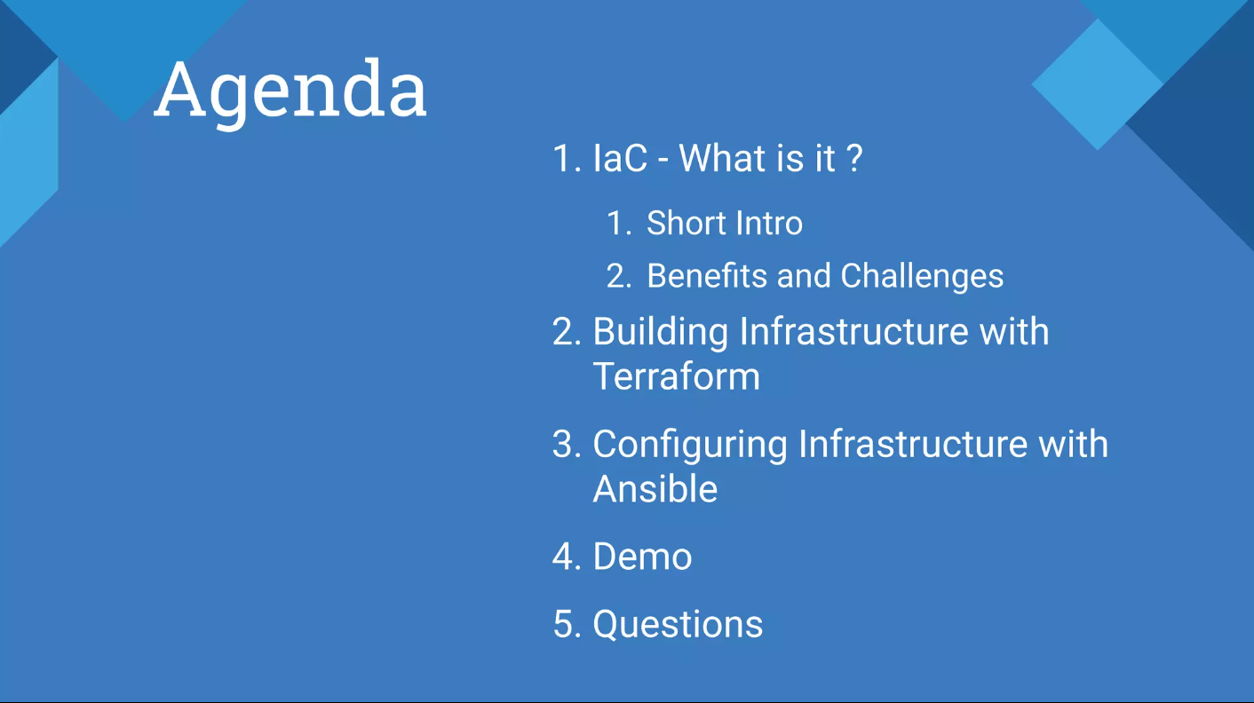

Slide 3
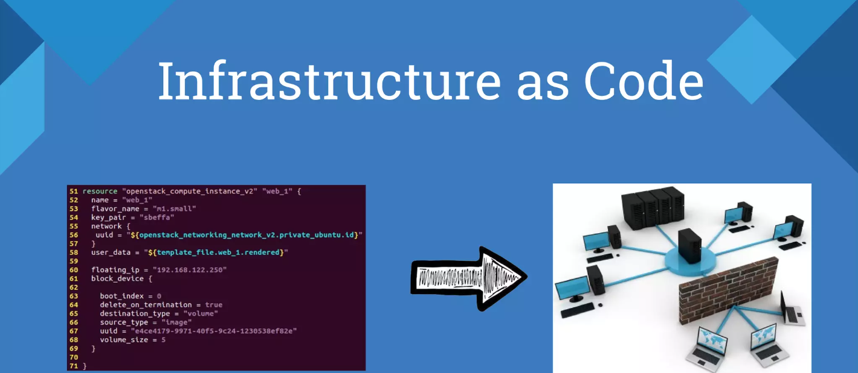

Slide 4
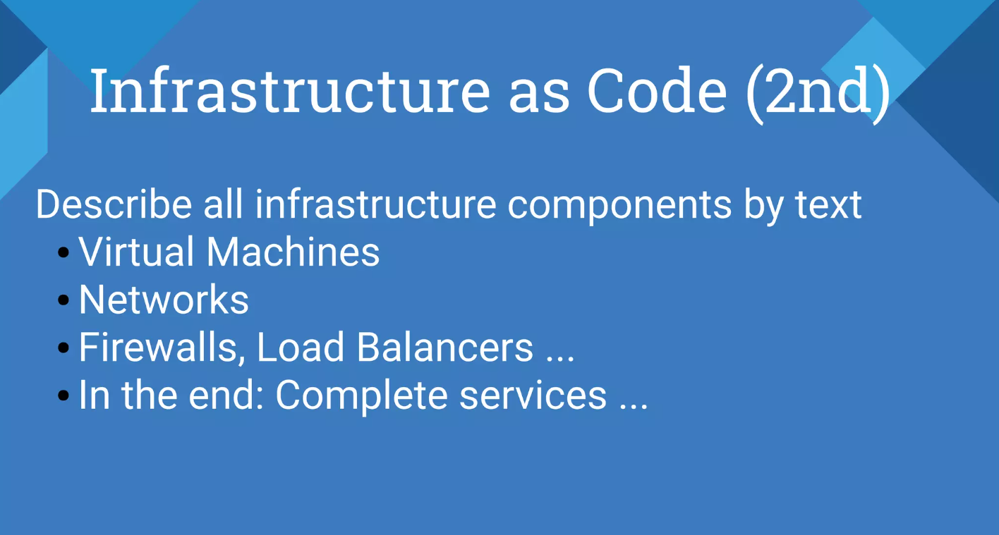

Slide 5
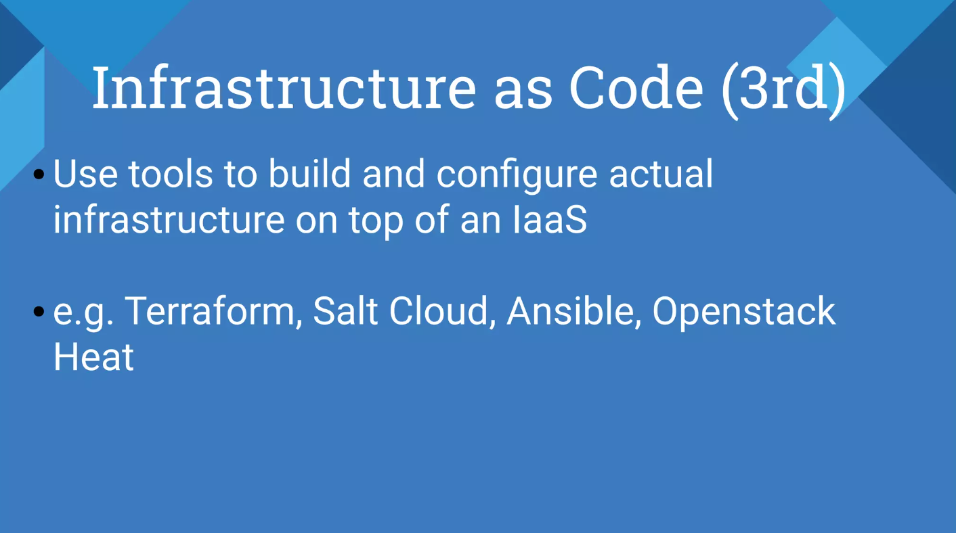

Slide 6
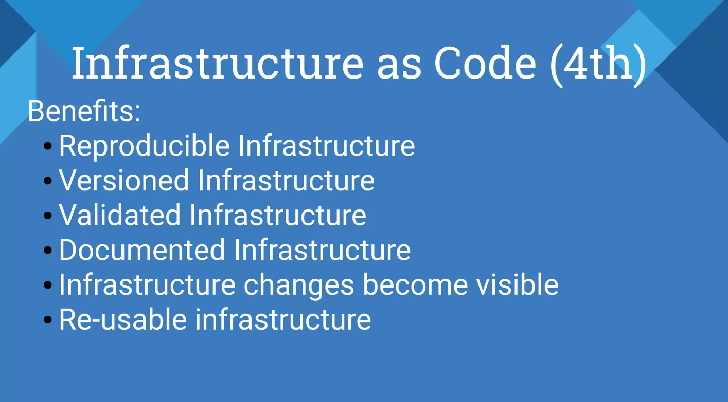

Slide 7
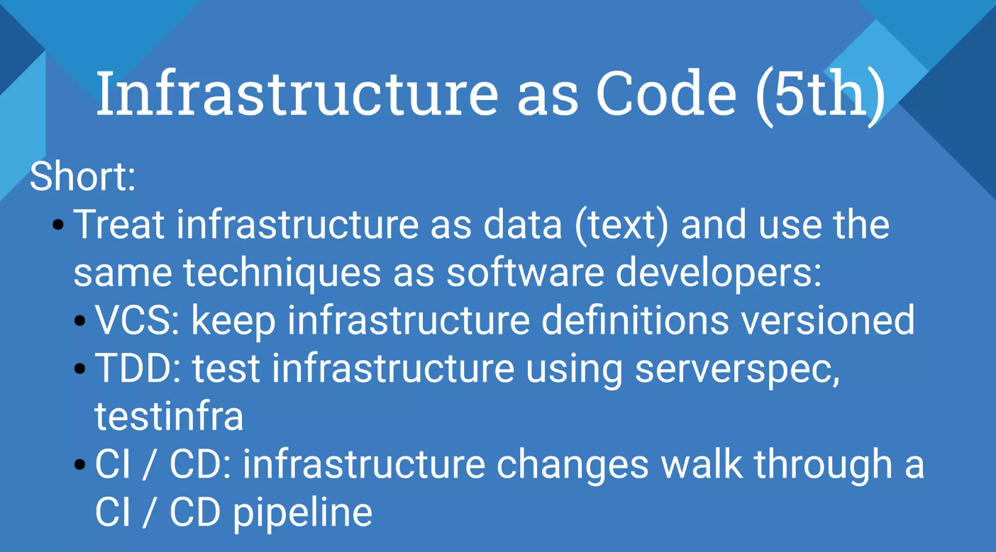

Slide 8
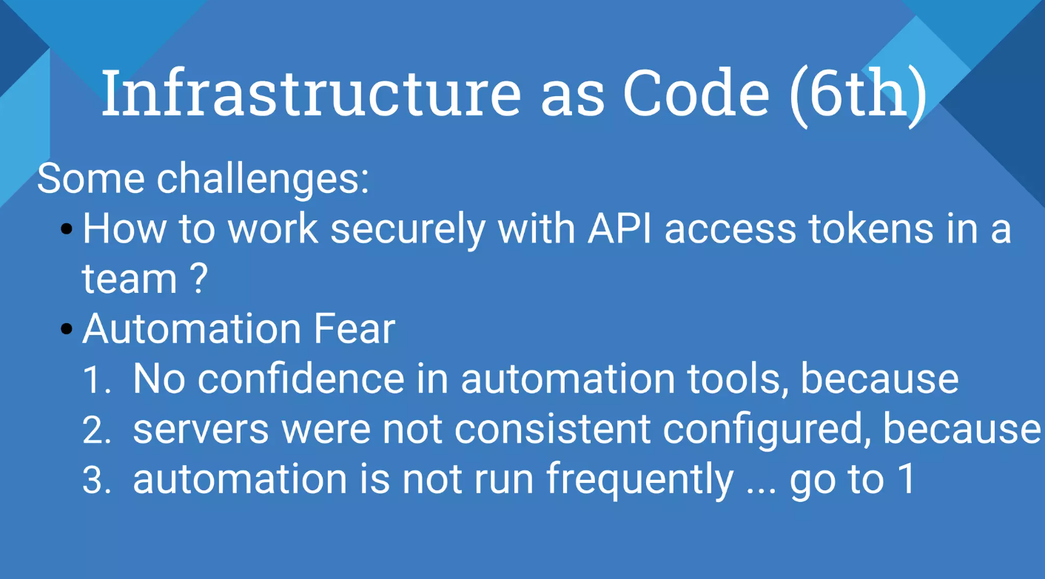

Slide 9
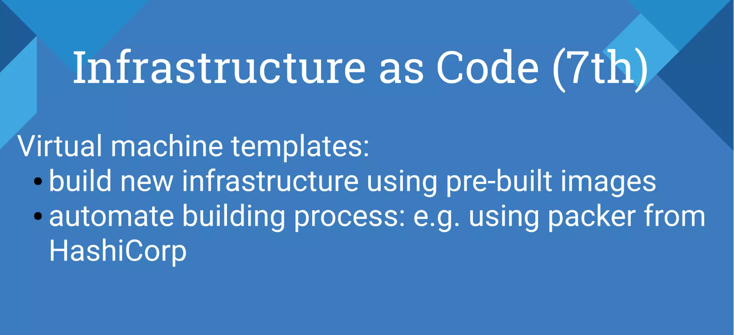

Slide 10
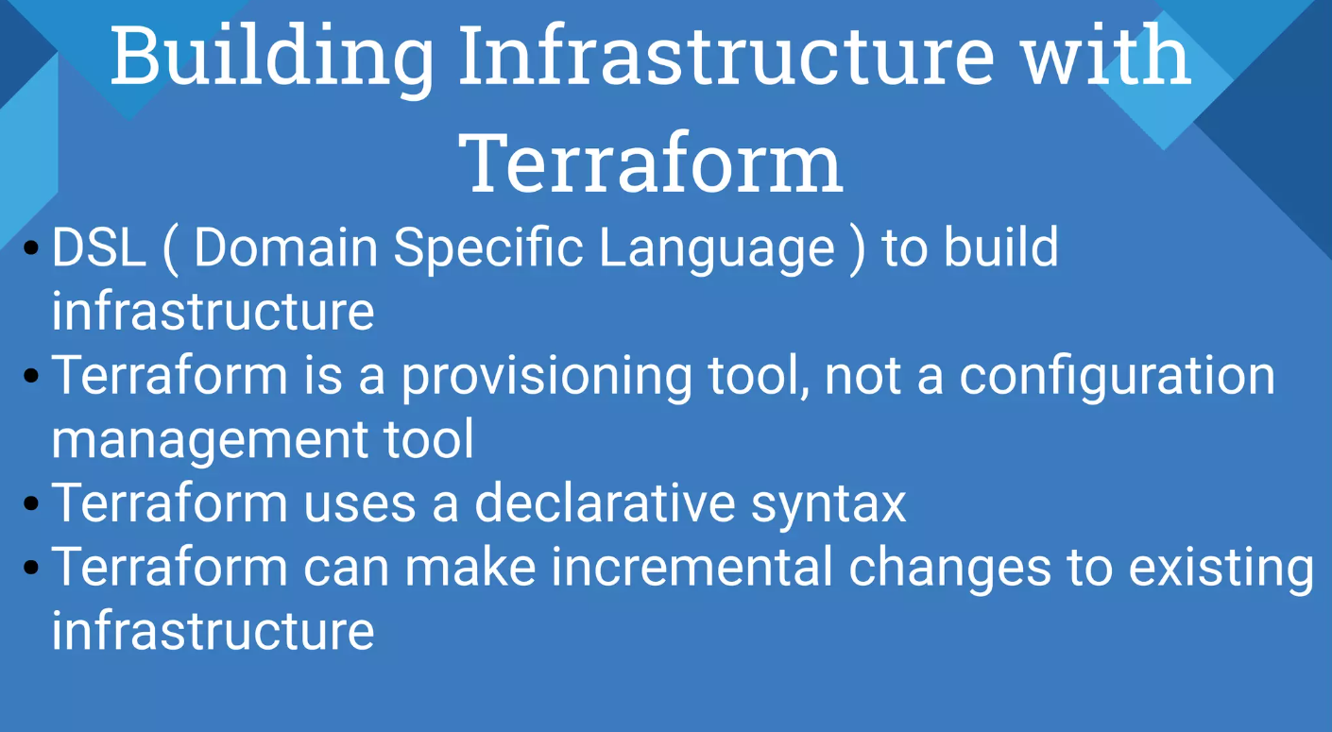

Slide 11
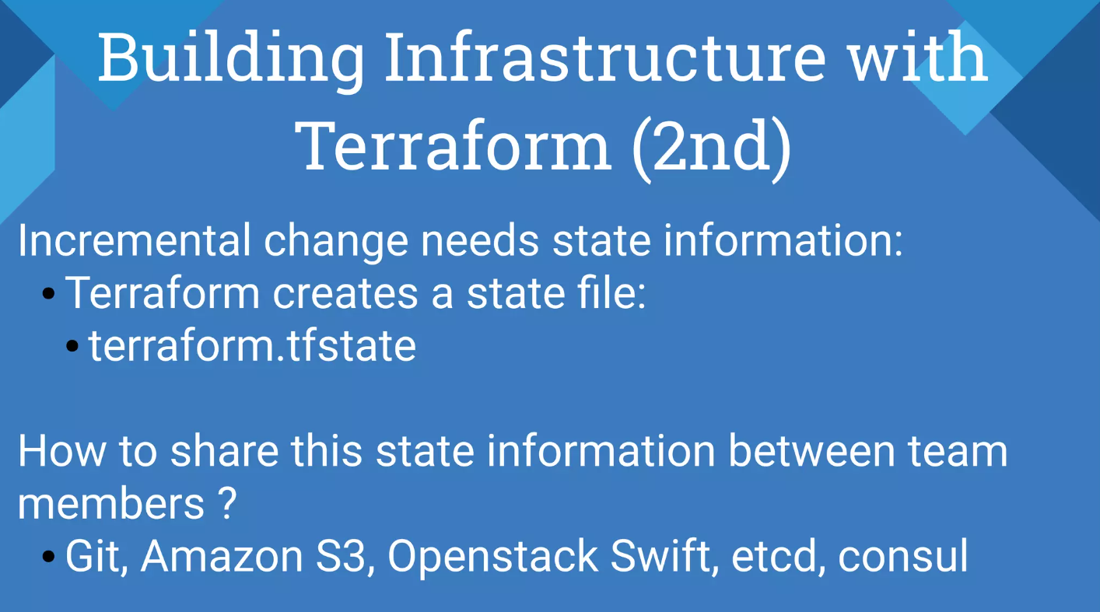

Slide 12
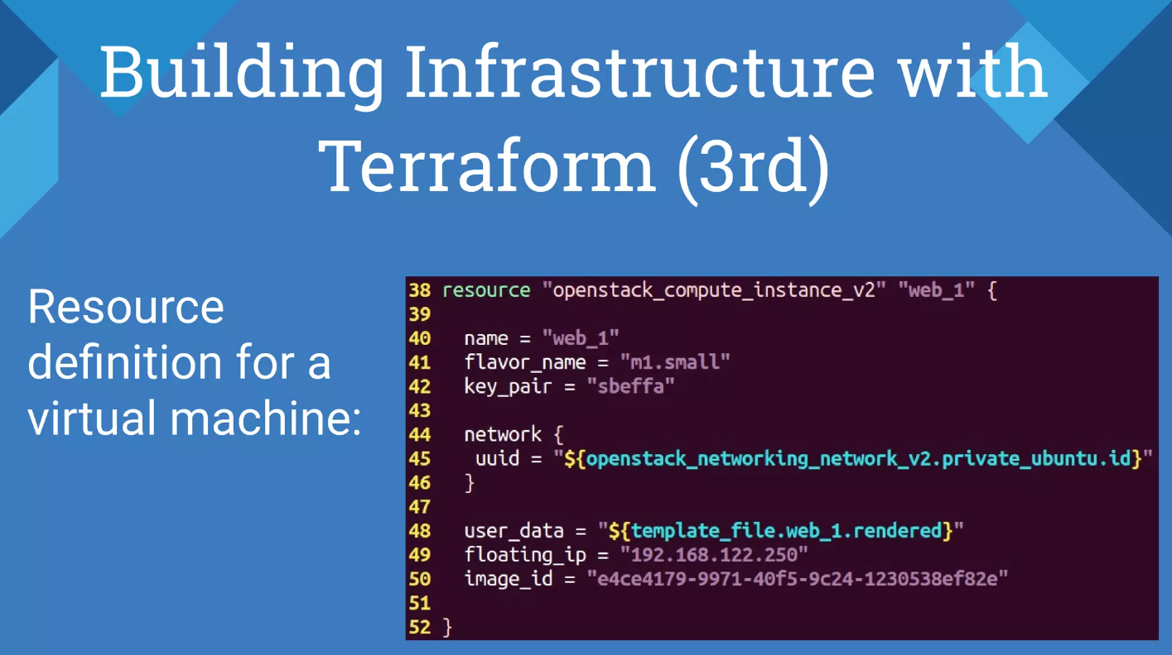

Slide 13
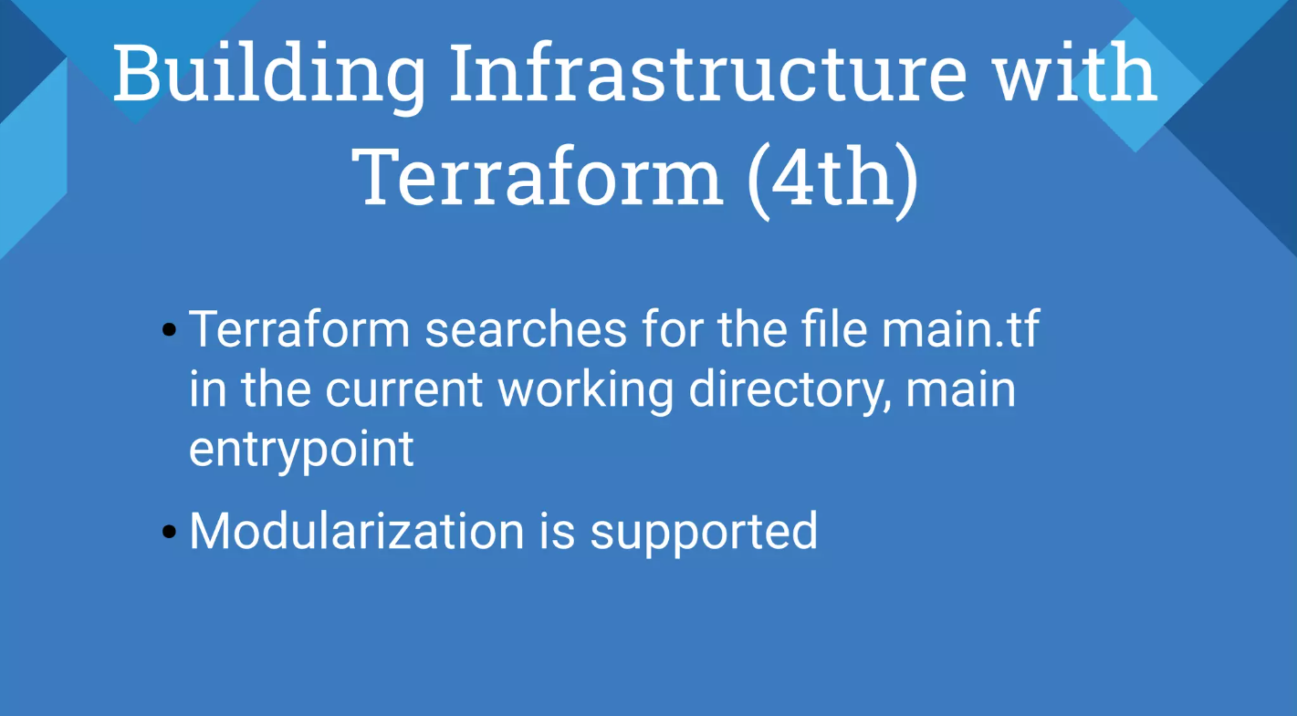

Slide 14
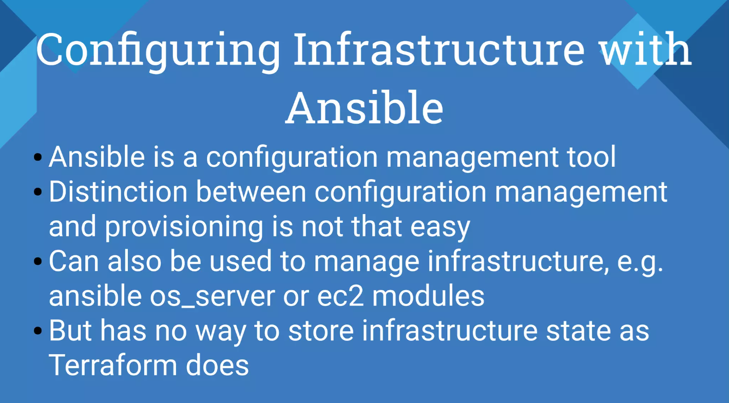

Slide 15
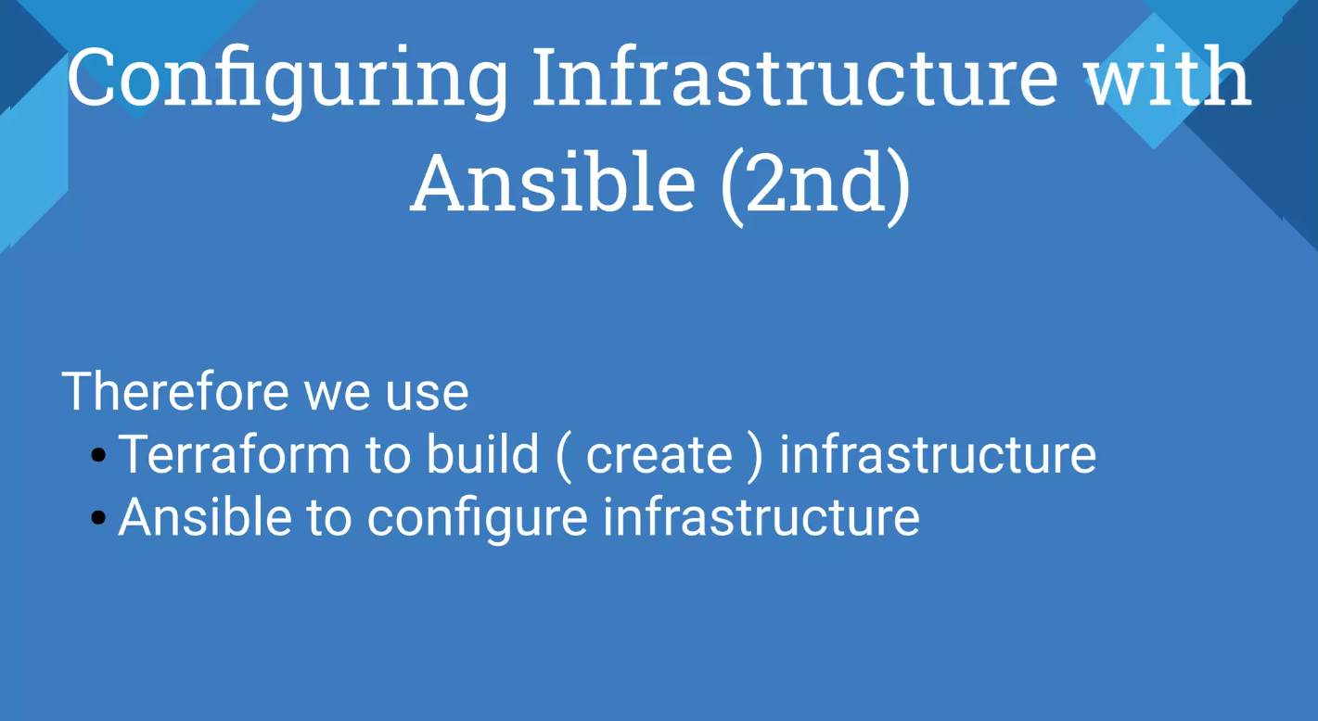

Slide 16
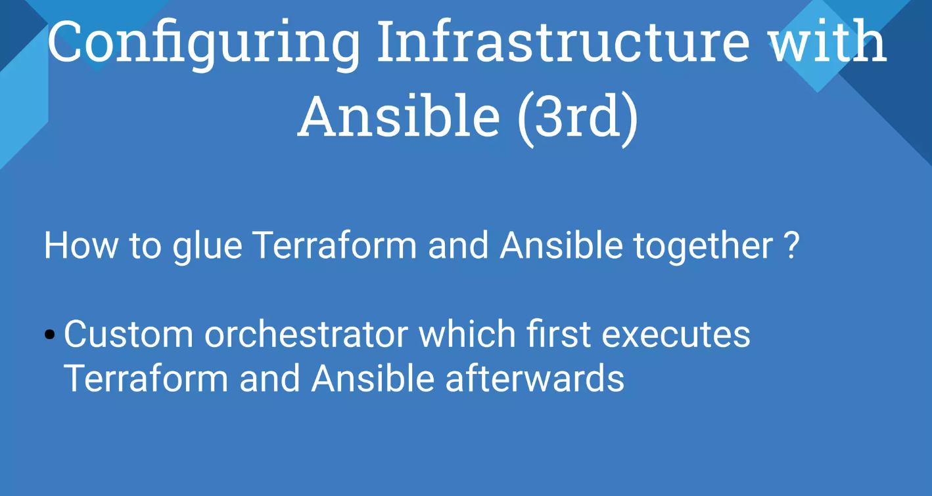

Slide 17
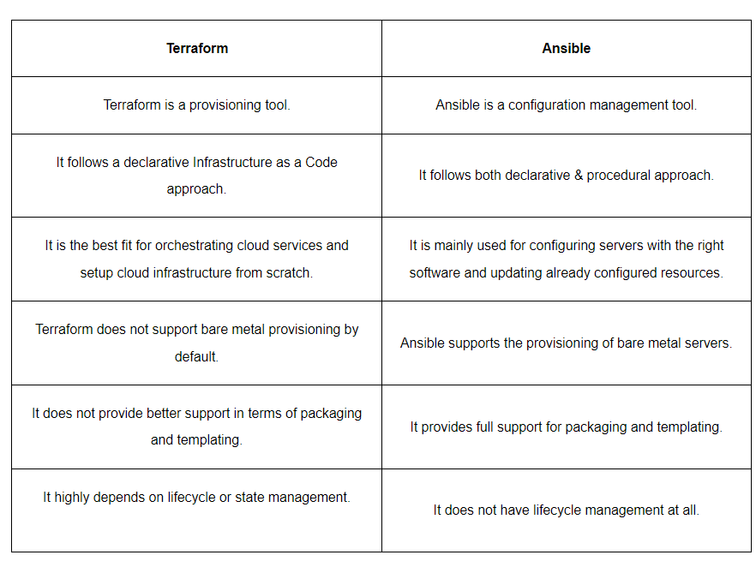
Difference between Terraform and Ansible Provisioning (Terraform vs. Ansible)

Slide 18
References
Terraform vs. Ansible: Key Differences and Comparison of Tools - https://k21academy.com/ansible/terraform-vs-ansible/#:~:text=Terraform%20is%20a%20tool%20designed,for%20automation%20across%20various%20domains.
Ansible vs. Terraform Demystified -
https://www.ansible.com/blog/ansible-vs.-terraform-demystified
Working with Terraform and Ansible | Choosing the Ultimate IaC Tool (Youtube) –
https://www.youtube.com/watch?v=zFwUaPwuJxU

Slide 19


